Slide 1
Employee Data Analysis using Excel
STUDENT NAME: shanmugam s
REGISTER NO: 312204226
DEPARTMENT: Bcom ( accounting and finance)
COLLEGE: annai violet arts and science college

Slide 2
PROJECT TITLE
Creating an Employee Performance scorecard in Excel

Slide 3


AGENDA
Problem Statement
Project Overview
End Users
Our Solution and Proposition
Dataset Description
Modelling Approach
Results and Discussion
Conclusion
3/21/2024 Annual Review

Slide 4

PROBLEM STATEMENT
: Develop an employee performance scorecard in Excel that consolidates key performance metrics (e.g., productivity, quality of work, attendance, teamwork) into a single score. The scorecard should allow for weighted metrics, provide a clear overview of performance

Slide 5

PROJECT OVERVIEW
The Employee Performance Scorecard in Excel will serve as a tool to evaluate and track employee performance across key metrics such as productivity, quality of work, attendance, and teamwork. It will incorporate weighted scores to reflect the importance of each metric and calculate an overall performance score.
.

Slide 6

WHO ARE THE END USERS?
**End Users**: The end users of the Employee Performance Scorecard in Excel are primarily **HR managers**, **team leaders**, and **supervisors** who will use it to evaluate employee performance. **Employees** may also access it for self-assessment and feedback purposes.

Slide 7

OUR SOLUTION AND ITS VALUE PROPOSITION
customizable Employee Performance Scorecard in Excel that tracks key performance metrics, applies weighted scoring, and offers visual insights through conditional formatting

Slide 8
Dataset Description
**Dataset Description**: The dataset for the Employee Performance Scorecard includes: - **Employee Details**: Name, department, role. - **Performance Metrics**: Productivity, quality of work, attendance, teamwork, etc. - **Scores**: Numeric values (e.g., out of 10) for each metric.

Slide 9

THE "WOW" IN OUR SOLUTION
Our Employee Performance Scorecard in Excel is simple yet powerful, offering customizable, automated scoring with weighted metrics, real-time visual performance insights, and intuitive data entry. It eliminates manual calculations, ensures objective evaluations, and provides a dynamic, user-friendly experience that scales with team needs—making performance management effortless and transparent.
3/21/2024 Annual Review
9

Slide 10
MODELLING
The Employee Performance Scorecard uses a weighted scoring model, where each performance metric (e.g., productivity, quality, attendance) is assigned a percentage weight based on its importance. Scores for each metric are input manually or through automated data collection, and the weighted formula aggregates them into an overall performance score. Conditional formatting and visualizations further model employee performance trends and insights for easy interpretation.
10

Slide 11
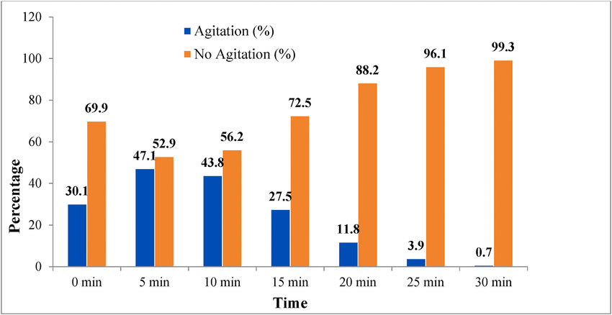
RESULTS
11

Slide 12
conclusion
**Conclusion**: The Employee Performance Scorecard in Excel is an effective tool for enhancing performance management. By integrating key metrics, weighted scoring, and visual insights, it simplifies evaluations and fosters a culture of accountability and continuous improvement. This solution not only aids in fair and objective assessments but also empowers employees to understand their performance and development areas, ultimately driving organizational success.

